Slide 1
Energy Efficiency and Emissions of Optimizers: A deeper look into the hyperparameters of deep learning models
By: Md Asif Mahmod Tusher Siddique
Supervisor: Dr Ah-Lian Kor

Slide 2
Contents
Introduction
Research goals
Literature review
Methodology
Results and discussion
Summary

Slide 3
Introduction
ML and DL is getting used in everyday tasks such as Virtual personal assistants, Traffic predictions, surveillance, Spam/Malware filtering, recommendation systems.
An individual deep learning model can contribute up to 626,155 pounds of CO2 emissions (Strubell et al., 2019).
Open-AI used 27,647 kilowatt hours of energy to train GPT-3 (TechTarget, 2021).
Optimizers influence the pace of training and ultimate prediction performance

Slide 4
Research goals
Literature review on the environmental impact of ICT, ML, DL, and ultimately optimizers
Implement deep learning model to test optimizers
To measure the energy consumption of optimizers with Joulemeter
To assess carbon footprint of optimizers
To evaluate results, use statistical testing

Slide 5
Literature review
According to (Dimitrova & Dimitrovski, 2020) Machine learning models consume quite a lot of energy while training, and are very power hungry
García-Martín et al (2019) says that there are not enough techniques to compute and develop energy models in current ML frameworks
Mazouz (2017) proposes a method for modelling energy use at the architectural and instructional levels.
According to Choi et al. (2019) the hyperparameter search space might be the singular most relevant element

Slide 6
Literature review
Schneider et al. (2019), says some optimization techniques might well be able to extend faultless scaling over numerous models
Okewu et al. (2019), compared stochastic optimizers in relation to the learning time convergence rate
Schmidt et al. (2021), carried out an extensive (More than 50,000 individual runs) scrutiny on popular 15 deep learning optimizers
A plant disease classification using different CNN and disparate optimizers of deep learning models done by Saleem et al., (2020).

Slide 7
Methodology
Micro methodology
Life cycle assessment
Macro methodology
Data collection and preprocessing
Implement model with different optimizers
Measure energy consumption using joulemeter
Calculate carbon footprint

Slide 8
Results and discussion

Slide 9
Results and discussion

Slide 10
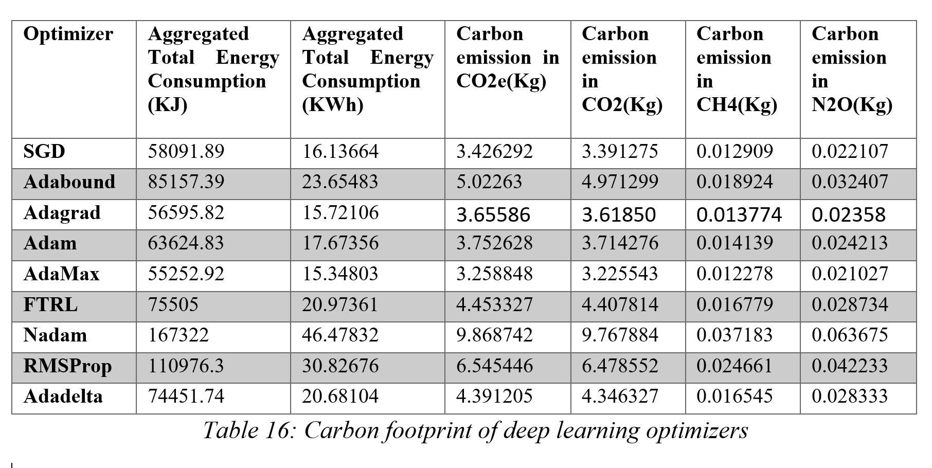
Results and discussion

Slide 11
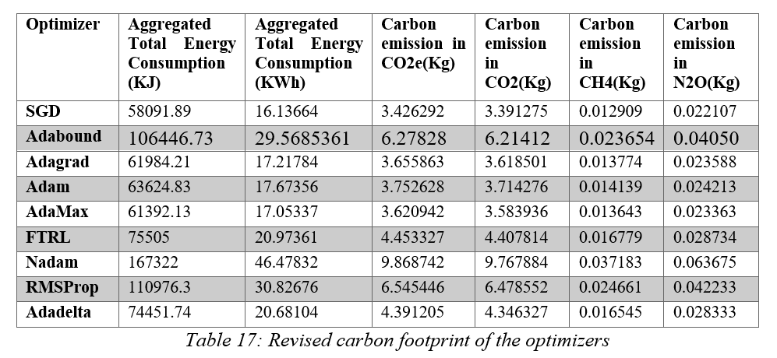
Results and discussion

Slide 12
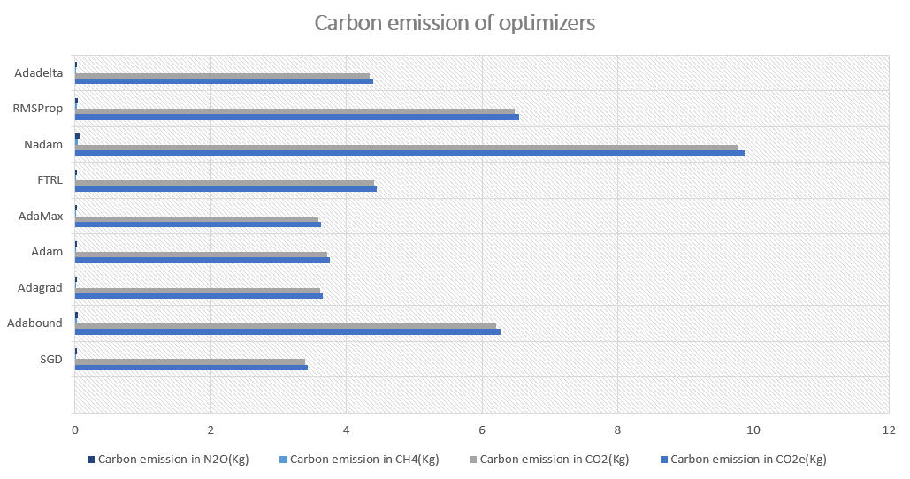
Results and discussion

Slide 13
Conclusion
Optimizers indeed contribute to the energy efficiency and carbon footprint
SGD has proven to be the most efficient while considering energy efficiency and GHG emissions
Results of Adagrad and AdaMax very close to SGD
Other hyperparameters of the deep learning models can be tested in the future

Slide 14
Thank you

Slide 15
References
Strubell, E., Ganesh, A. and McCallum, A., 2019. Energy and policy considerations for deep learning in NLP. arXiv preprint arXiv:1906.02243.
Mark Labbe, 26 Aug 2021. Energy consumption of AI poses environmental problems. Available at: https://www.techtarget.com/searchenterpriseai/feature/Energy-consumption-of-AI-poses-environmental-problems#:~:text=AI%20energy%20consumption%20during%20training&text=A%20single%20V100%20GPU%20can,27%2C648%20kilowatt%20hours%20(kWh). (Accessed: 9th April 2022).
García-Martín, E., Rodrigues, C.F., Riley, G. and Grahn, H., 2019. Estimation of energy consumption in machine learning. Journal of Parallel and Distributed Computing, 134, pp.75-88
Mazouz, A., Wong, D.C., Kuck, D. and Jalby, W., 2017, April. An incremental methodology for energy measurement and modeling. In Proceedings of the 8th ACM/SPEC on International Conference on Performance Engineering (pp. 15-26).
Choi, D., Shallue, C.J., Nado, Z., Lee, J., Maddison, C.J. and Dahl, G.E., 2019. On empirical comparisons of optimizers for deep learning. arXiv preprint arXiv:1910.05446.
Okewu, E., Adewole, P. and Sennaike, O., 2019, July. Experimental comparison of stochastic optimizers in deep learning. In International Conference on Computational Science and Its Applications (pp. 704-715). Springer, Cham.
Schmidt, R.M., Schneider, F. and Hennig, P., 2021, July. Descending through a crowded valley-benchmarking deep learning optimizers. In International Conference on Machine Learning (pp. 9367-9376). PMLR.
Saleem, M.H., Potgieter, J. and Arif, K.M., 2020. Plant disease classification: A comparative evaluation of convolutional neural networks and deep learning optimizers. Plants, 9(10), p.1319.

